Slide 1
Aggie Grads and Brags May 23, 2017
Honoring recent graduates and scholarship recipients

Slide 2
Kaylee Black ‘17
Major: Animal Science
Parents: Kim and Jeff Sessions

Slide 3
Maggie Blackwell ‘17

Slide 4
Maggie Blackwell ‘17
Parents: Patrick and Julie Blackwell
Summa Cum Laude BS in Electrical Engineering with a minor in Math
Aggie Sweethearts, Society of Women Engineers, Aggies Support USO, Tau Beta Pi
President’s Endowed Scholarship, MB Krischer Memorial Scholarship
Maggie will pursue a Masters of Science in Electrical Engineering specializing in power electronics at University of Illinois Urbana-Champaign.

Slide 5
Elliott Condos ‘17
Parents: Linda and Michael Kimble

Slide 6
Mark Hendrick ‘17
Major: Management
Parents: Jo and David Hendrick

Slide 7
Brayah Hinesman ‘17

Slide 8
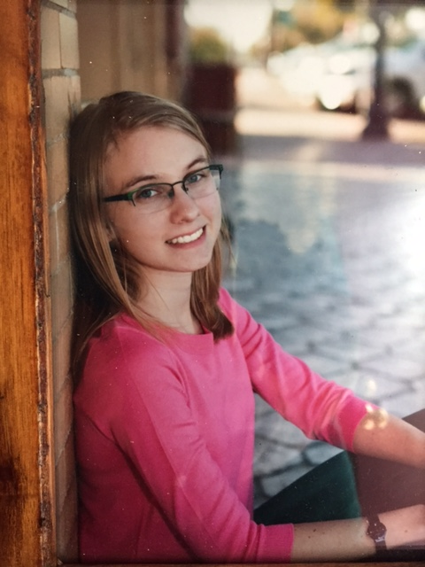
Brayah Hinesman ‘17
Parents: Rodney and Sherry Hinesman
B.S. in Biomedical Science with a minor in Genetics
Organizations: Carpool
Brayah has already started her first job at Dessau Vet Clinic, training as a vet tech. She plans to keep working and learning until applying to veterinary schools, to attain her ultimate goal of becoming a veterinarian.

Slide 10
Audrey Housson ‘17

Slide 11
Audrey Housson ‘17
Parents: Shannon and Charla Housson
Magna Cum Laude with a BS in Geology and GIST
Chi Omega; the Big Event Staff Assistant; Student worker
Dean’s List
Audrey will be a Project Coordinator for Atkinson Construction in Austin.

Slide 13
Valerie Jones ‘17
Major BIMS
Parents: Dianna and Reinhard

Slide 14
Alex C. Lambros ‘17

Slide 15
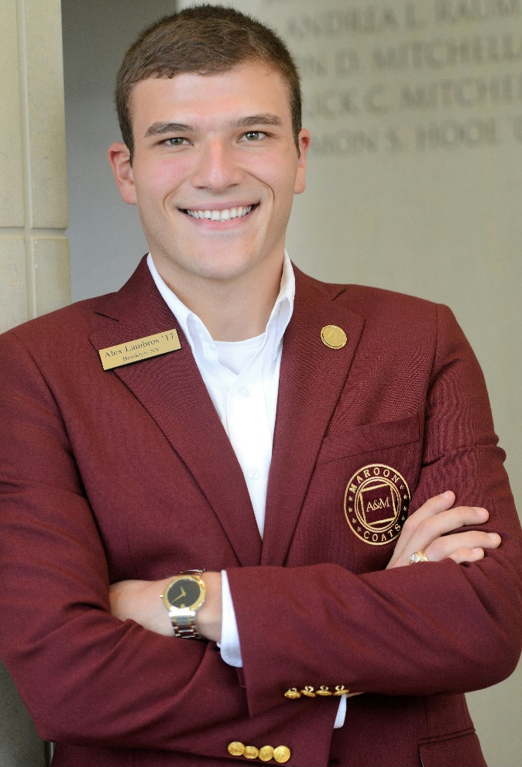
Alex C. Lambros ‘17
Petroleum Engineering and Geology
Mom: Lisa Tropea
Magna Cum Laude
Buck Weirus Spirit Award
Maroon Coat
Society of Petroleum Engineers
Alex will be working for Chevron.

Slide 17
Emily Naveira ‘17

Slide 18
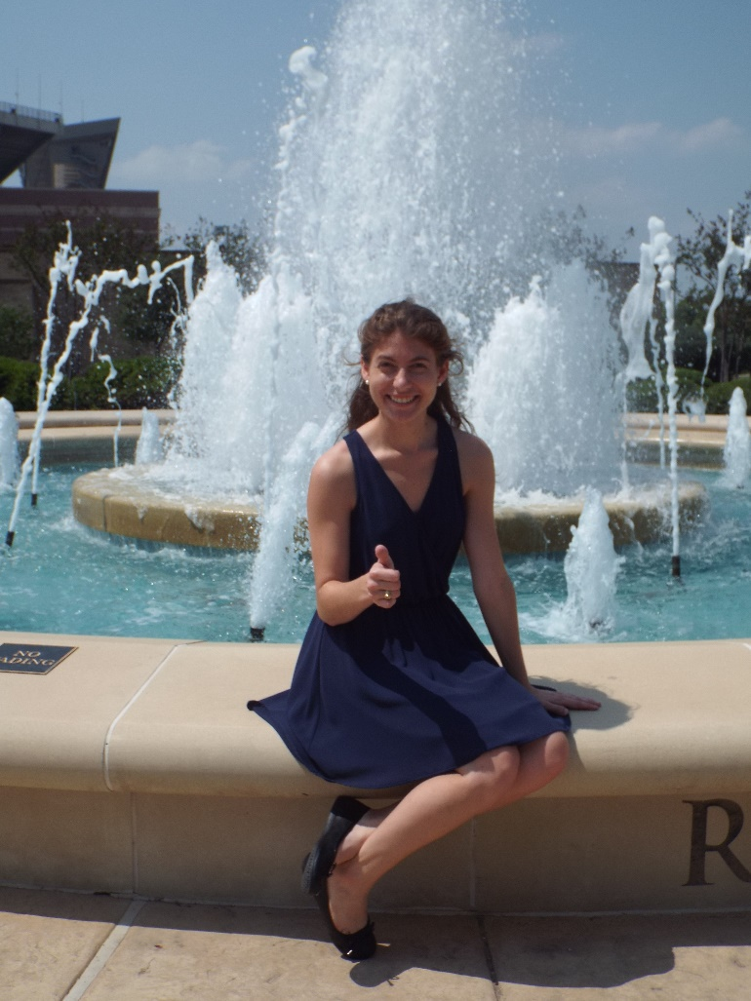
Emily Naveira ‘17
Major: Cum Laude in Psychology
Parents: Becky and Jose Naveira
Organizations: TANSA; Psi Chi; Geology/Geophysics Club
Honors: Phi Beta Kappa, Sigma Tau Delta, Dean’s List

Slide 19
Brittany O’Beirne ‘17

Slide 20
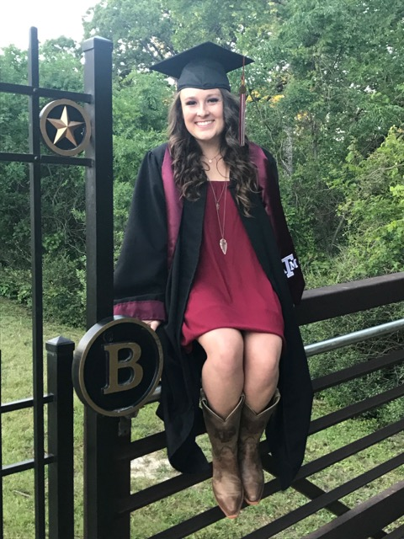
Brittany O’Beirne ‘17
Parents: Patrick and Laurie O’Beirne
Summa Cum Laude with a BS in Kinesiology
Organizations: Physical Therapy Society, Texas A&M Starlight Program, Texas A&M Big Event, SMYRT
Brittany is taking a gap year off for mission work prior to pursuing a career in Physical Therapy

Slide 22
Sophie Sanchez ‘17

Slide 23
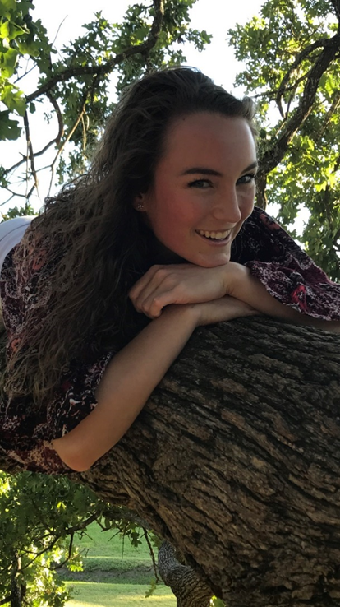
Sophie Sanchez ‘17
Parents: Ashley and Hector Sanchez
Magna Cum Laude with BS in Biology and a minor in Neuroscience and Psychology
Women's Club Soccer
SANDI- Students Advancing Neuroscience Discovery and Innovation
Dean's Honor Roll
LSAMP Undergraduate Research Scholar
Sophie will be attending graduate school at the University of Texas to pursue a PhD in neuroscience.

Slide 24
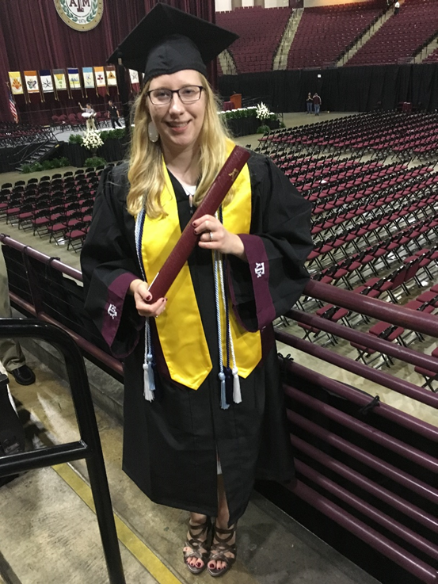
Ruth Stephens ‘17
Graduated May 12, 2017 Cum Laude with a Bachelor of Science in Human Resource Development with a double minor in Business and Communication
Parents: Ed & Betty Joyce Stephens
Involved in "Society of Human Resources Management " organization, National Society of Leadership and Success, and Big Event.
Received certification for: SHRM Assurance of Learning
After graduation will be working in a Human Resources Internship.

Slide 26
Travis White ‘16

Slide 27
Travis White ‘16
Major—Petroleum Geology
Parents---Danny ’86 and Jana ‘87 ;Brother---Jake ’19;Family—Gary Gibson ‘61, Greg Gibson ’90
Aggie Experience Council;Big Event
Heading to grad school Fall 2017 to pursue MS Petroleum Geology

Slide 28
Congratulations, Graduates!

Slide 29
We are so proud of you!

Slide 30
A donation of $25 has been made in your honor to go toward one of your first three years of membership in The Association of Former Students.

Slide 32
Scholarships

Slide 33
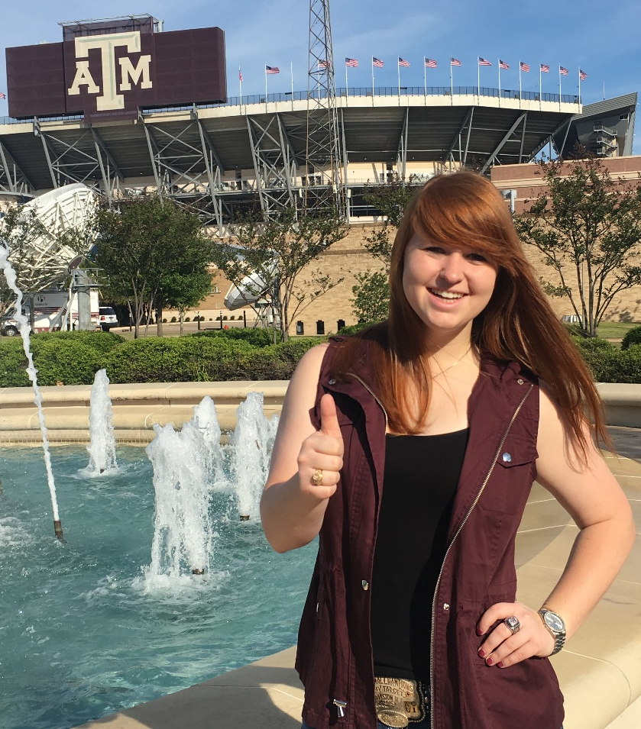
Kirby Bohls ‘18
Animal Science,Business Administration, and Meat Science
Animal Science Aggie REPs, Trap and Skeet Team, Texas A&M Saddle & Sirloin, 2016 Aggie Meat Judging Team, Texas A&M Texas Trophy Hunter's Association
Dean's Honor Roll, College of Agriculture and Life Sciences Distinguished Student Award, Texas A&M Department of Animal Science Scholarship Recipient, 2nd Place Individual at Eastern National Meat Judging Contest, 2015 Collegiate Clay Target National Champions, National Society of Leadership and Success Acceptance

Slide 34
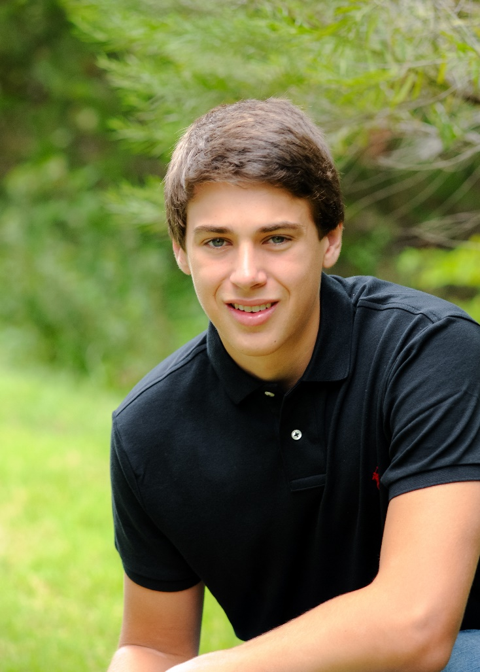
Taylor Boles ‘19
Major: Biomedical Engineering
Organizations: Alpha Phi Omega Service Fraternity
Honors: Distinguished Student Award; Dean's Honor Award; Phi Eta Sigma National Honor Society inductee; Physics 218 Mechanics Scholar Award of Exceptional Performance

Slide 36
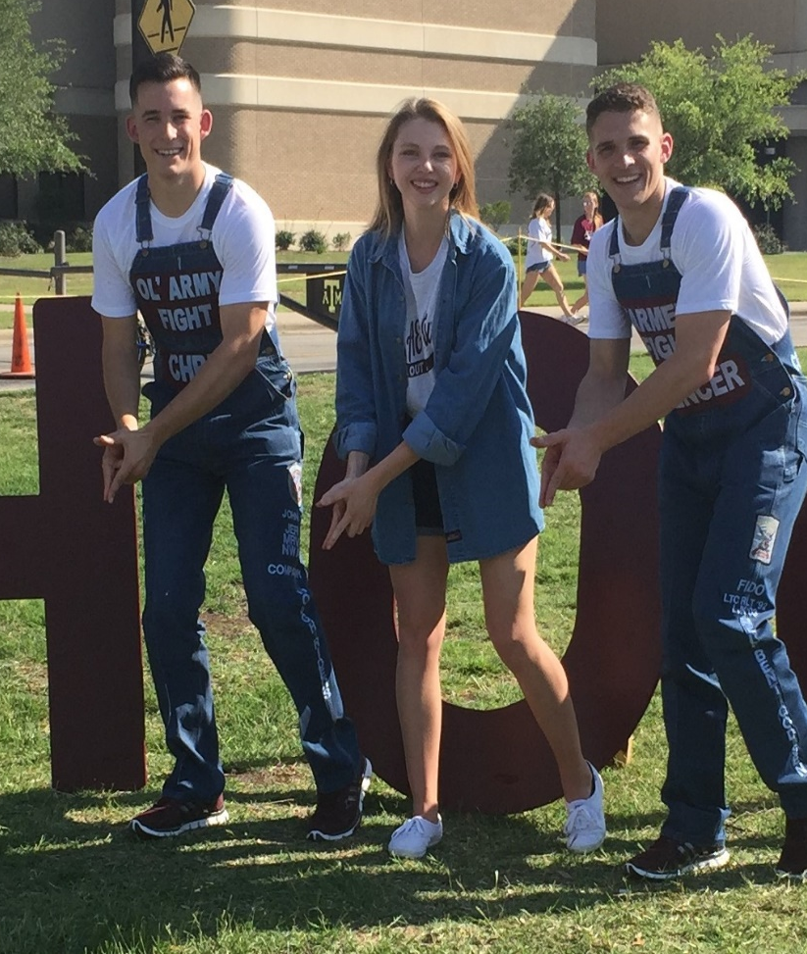
Hannah Cartwright ‘19
Business Management
Organizations: Texas A&M Residence Life; Texas A&M Consulting Club

Slide 37
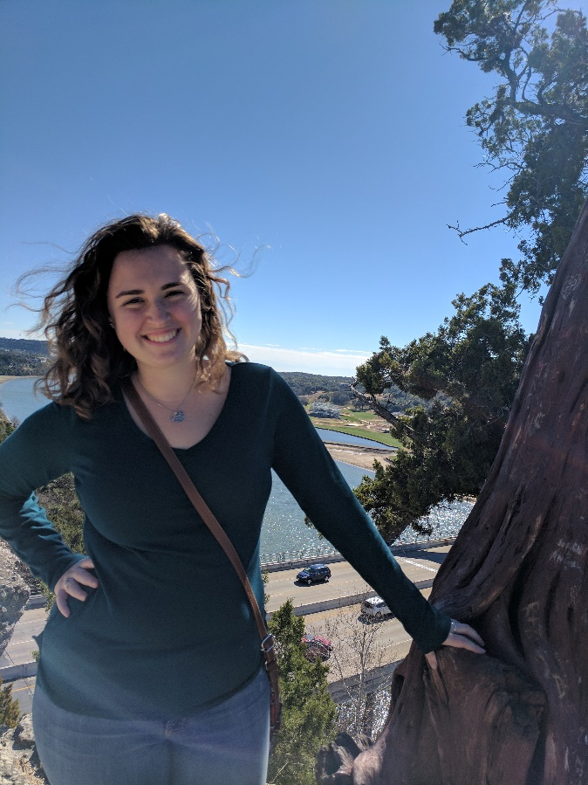
Katie Frierson ‘18
Major: Electronic Systems Engineering Technology
Minor: Business
Organizations: Autonomous Underwater Vehicle (AUV) Team; Society of Women Engineers; IEEE-Tech; Theme Park Organization; Electrical Sub-Team Lead for AUV
Honors: Distinguished Student Fall 2016;2nd Place Aggies Invent Fall 2014​

Slide 39
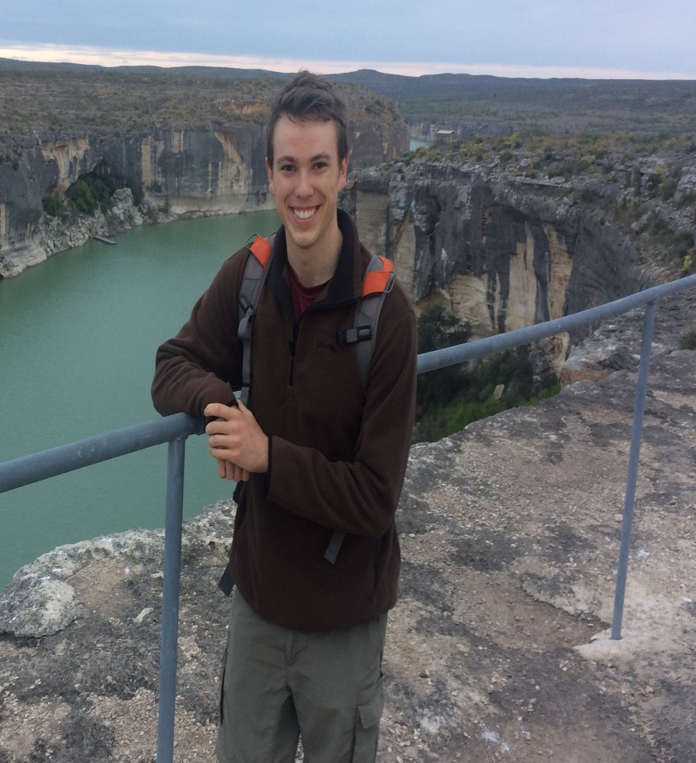
Jacob Hartzer ‘19
Major: Mechanical Engineering
Organizations: MSC Business Associates; Texas A&M National Scholar Ambassadors; Aggie Westies (West Coast Swing Dance Club); American Society of Mechanical Engineers
Honors:Brown Scholar; National Merit Scholar; Eagle Scout; 2nd Place in Math and Computer Science: Student Research Week; Harold W. Gains Excellent Service Award

Slide 40
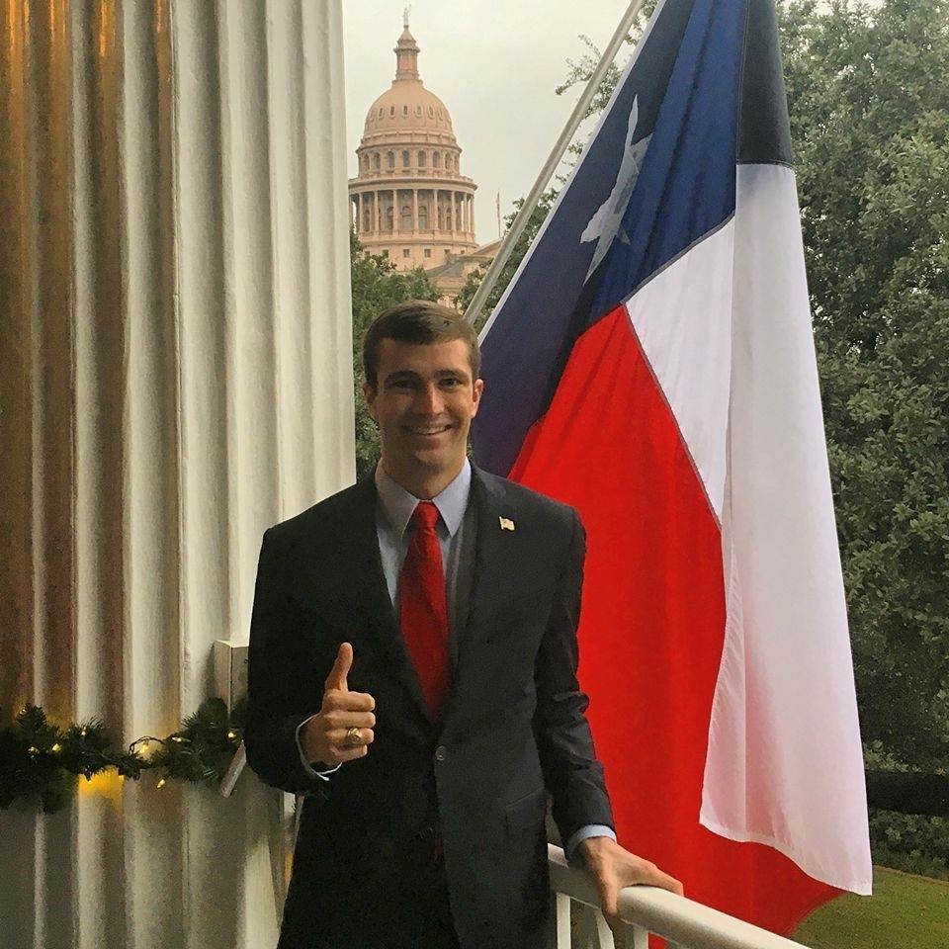
David L. Isenhour ‘18
Major: Petroleum Engineering
Organizations: Society of Petroleum Engineers, Pi Epsilon Tau Petroleum Engineering Honors Fraternity (President), College Republicans (Chairman), Petroleum Ventures Program (Student Program Development Team)
Honors: Graham Petroleum Ventures Scholarship, Southerland Leadership Award, Chevron Scholarship

Slide 41
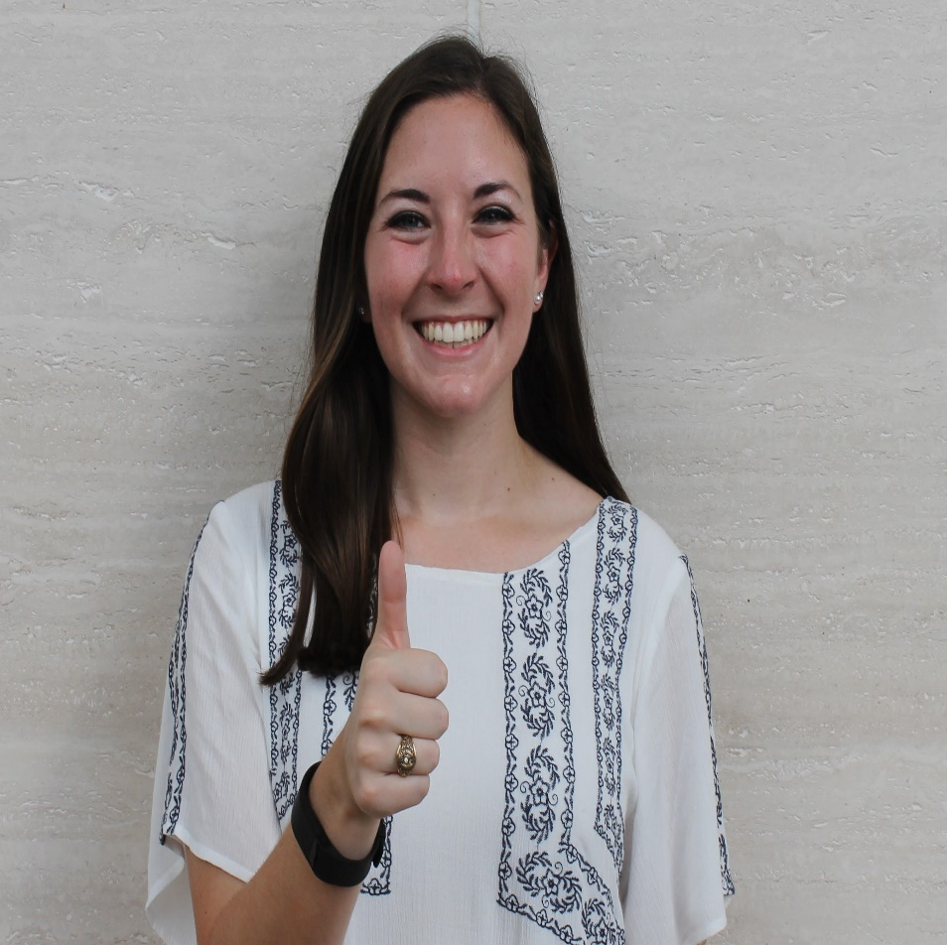
Rachel Keathley ‘18
Major: Business Honors and Management
Organizations: Student Government Executive Cabinet; Election Commission; Philadelphia Sisters; MSC Wiley Lecture Series
Honors: Phi Kappa Phi Mays Outstanding Junior; Buck Weirus Spirit Award; Gathright Scholar Award

Slide 42
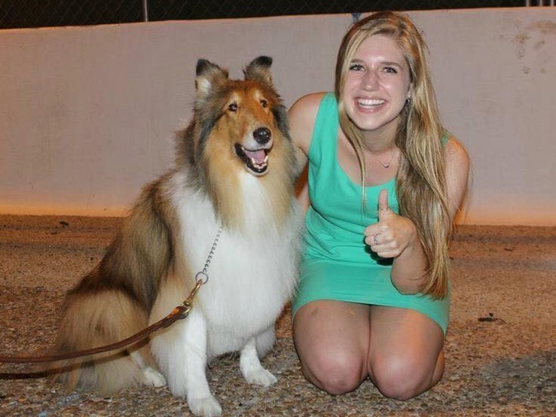
Madison Knight ‘19
Major: Elementary Education
Organizations: Pi Beta Phi Sorority, Fish Camp Counselor '16 and '17, MSC Lead
Honors: College of Education Dean’s List

Slide 43
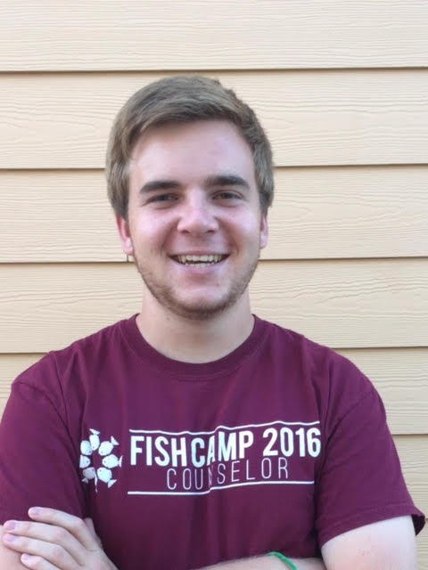
Bradley Kupper ‘19
Major: Computer Science
Organizations: MSC Aggie Leaders Of Tomorrow; Fish Camp Counselor ‘16 and ‘17
Honors: Spring 2016 Engineering Dean's Honor Roll

Slide 45
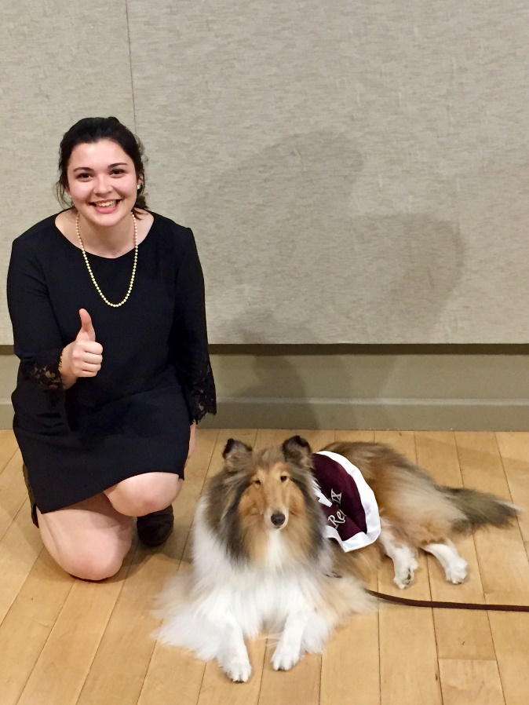
Morgan McMaster ‘19
Major: Political Science and Economics
Organizations: MSC SCONA, MSC Bethancourt, MSC FLI, MSC L.T. Jordan
Honors: Dean's List

Slide 46
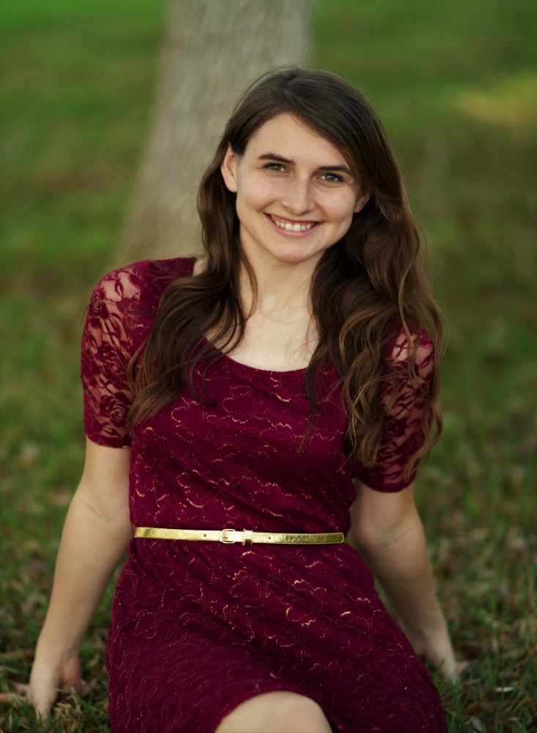
Ashley Naveira ‘19
Major: Business Honors/Management Information Systems
Organizations: MSC Hospitality, Texas A&M National Scholar Ambassadors, MSC Business Associates, SGA Election Commission, Business Honors, University Honors
Honors: Gathright Academic Excellence Award Finalist, Cynthia B. Taylor Endowed Scholarship

Slide 48
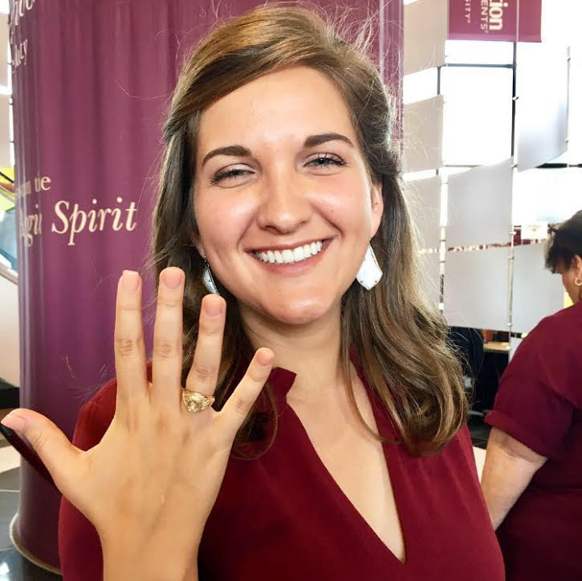
Brooke Oliver ‘18
Major: History and Political Science
Organizations: A&M Division of Marketing and Communications; Class Councils Ambassador; Aggie Experience Council Executive Team; IMPACT Camp Counselor
Honors: Association of Former Students Academic Excellence Scholarship Spring 2016, Spring 2017; Liberal Arts Dean’s Honor Roll Fall 2015, Spring 2016, and Fall 2016; The National Society of Collegiate Scholars; Phi Eta Sigma Honor Society

Slide 49
Morgan Riba ‘17
Major: Molecular and Cell Biology (Honors)
Organizations: Texas A&M Wind Symphony, University Honors Program, MSC ALOT, Lambda Sigma Society
Honors: 1st Place Undergraduate Poster at Student Research Week, 4.0 GPA Fall 2016 and Spring 2017

Slide 50
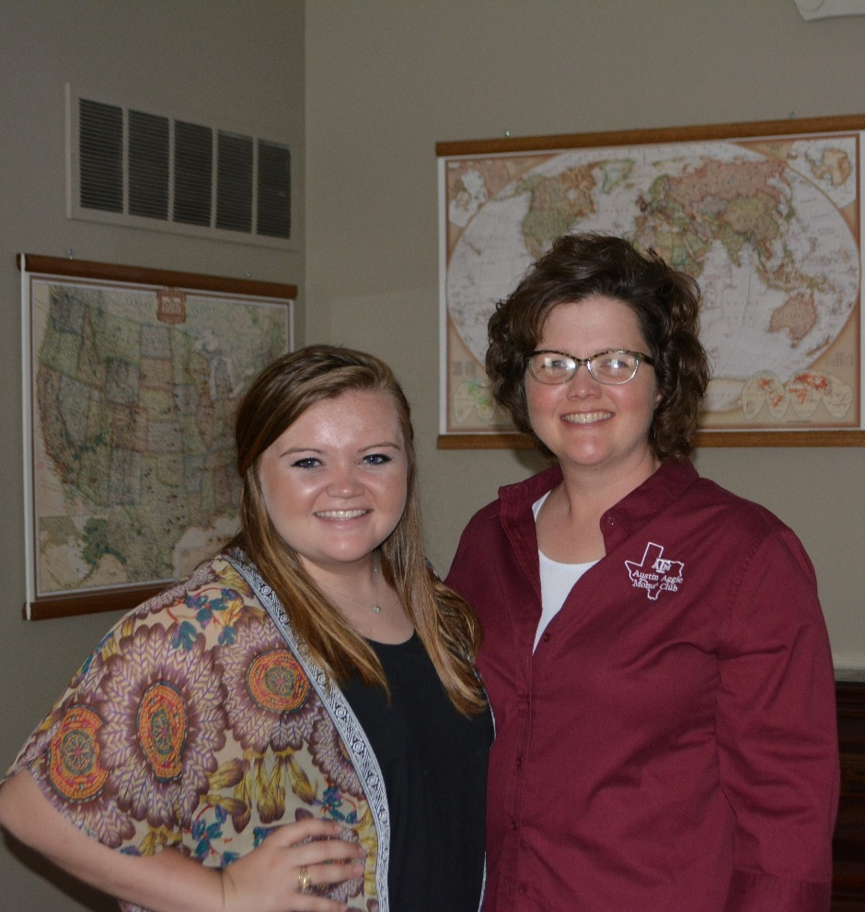
Anna Mae Schmidt ‘18
Major: Animal Science; Minor in Business Administration
Organizations: Meat Science Quiz Bowl Team, Texas A&M Animal Science Aggie Reps, Texas A&M Intercollegiate Meat Judging Team, Texas A&M Animal Science Saddle & Sirloin Club, College of Ag & Life Sciences: Freshman Leadership Experience
Honors: Ward Smith Memorial Scholarship, SMIKids Meat Industry Scholarship, LaSalle County Stockman’s Association Scholarship, Dewitt C & Bethel Winter Cox Education Fund Scholarship, Wesley Richardson Memorial Scholarship, JED Education Foundation Scholarship, First Presbyterian Church of Ottawa Scholarship, Ottawa Noon Rotary Scholarship

Slide 52
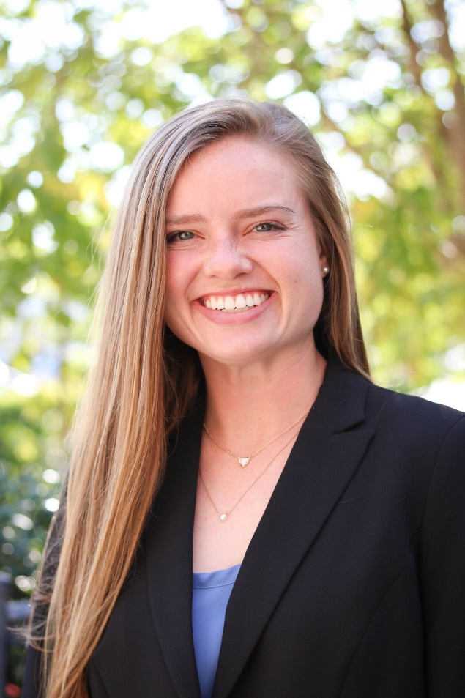
Kimberlee Southwell ‘18
Major: Finance
Organizations: Commercial Banking Program, Mays School of Business, Kappa Alpha Theta Member and Scholarship Director, Impact Counselor
Honors: Phi Eta Sigma National Honor Society, January 2015; General Motors Scholarship; May 2016; Mays Business School Scholarship, May 2016

Slide 53
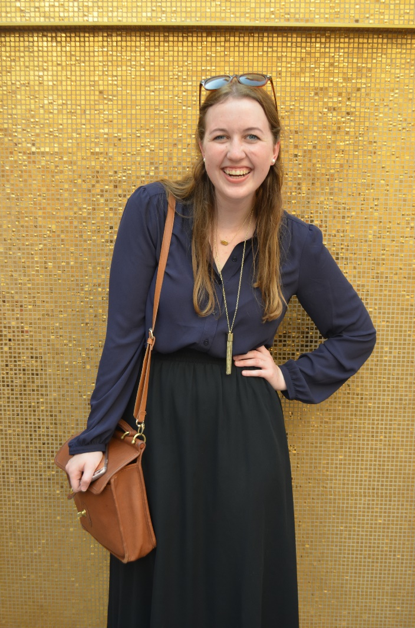
Ashley Taylor ‘19
Major: Aerospace Engineering
Organizations :University Honors Program Sophomore Advisor ~ Mentor students within the University Honors Program; American Institute of Aeronautics and Astronautics, General Engineering Representative, Society of Flight Test Engineers
Honors: Brad Worsham ’88 Scholarship Recipient; Indian Institute of Technology Kanpur Research Internship; Texas A&M University Scholars Program; University Honors Program; Texas A&M Engineering Honors Program; Peter Hunter Dunham ’74 Scholarship Recipient

Slide 54
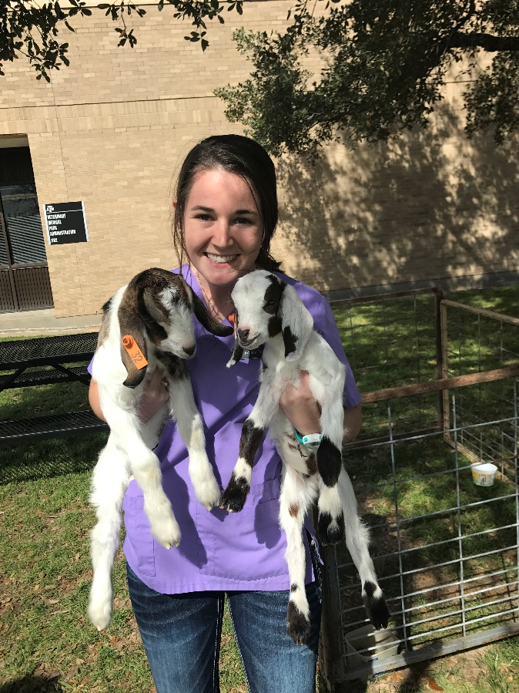
Bailey Todd ‘20
Major: Doctor of Veterinary Medicine
Organizations: Class of 2020 Student Council Vice President; Christian Veterinary Fellowship Secretary

Slide 56
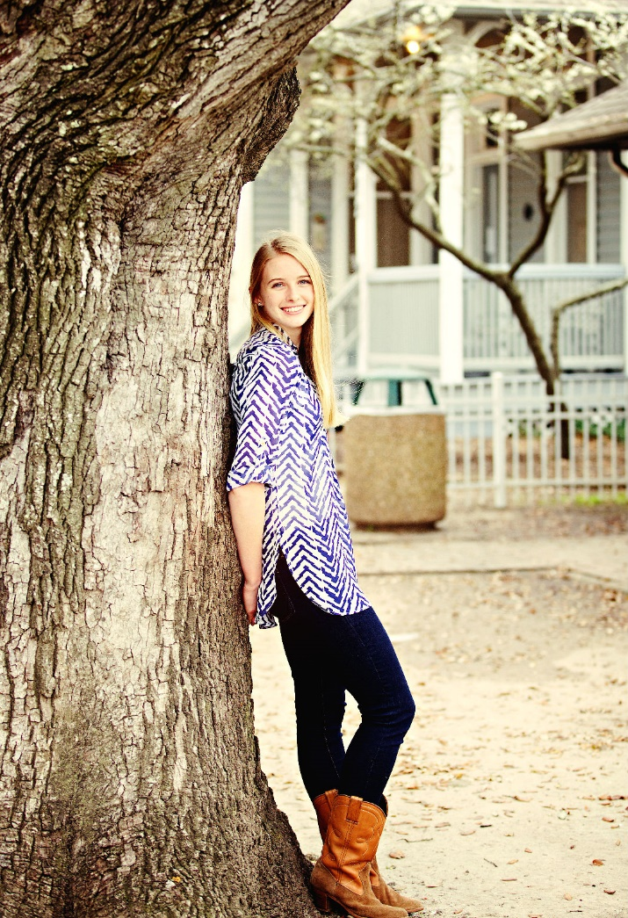
Amanda Wolken ‘18
Electrical Engineering Major
Organizations: BUILD, MSC Hospitality
Honors: University Honors, President's Endowed Scholar

